Slide 1
Blessings House Nursing Home
Business & Financial Plan

Slide 2
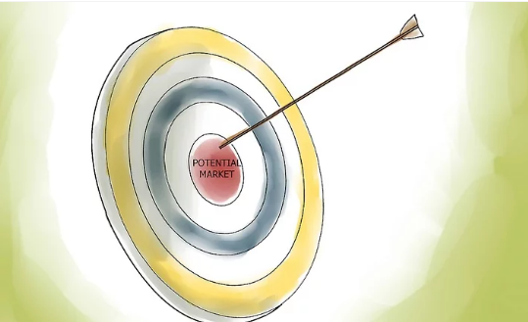
The potential markets for your business
It is crucial to understand that the business' market will be categorized as either the privately-paying residents or Medicare patients. Also, in market segmentation, it will be targeting the potential residents and also the families of the prospective residents.

Slide 3
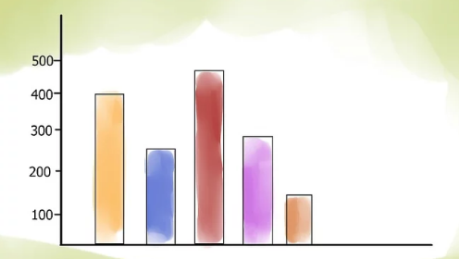
The size of your potential market
This number will create a strong basis for interpreting the target people for our products. Also, the number of private residents that our business will be handling their issues daily. Also, short stays will be targeted. Once they are targeted, they can be great customers for the enterprise.

Slide 4

Company’s initial needs
Initial Financials
Although these finances are not sufficient, it must be budgeted well to ensure that the amount will be enough to ensure that every activity is running well. The financial plan targets that, for the business to start up well, it should admit at least 20 aged people that the facility will be handling their issues. Through them, the activities of the business will be easily managed.

Slide 5
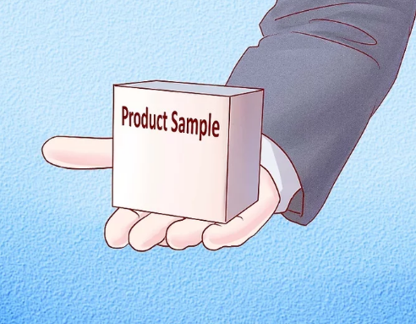
Product samples
The sample product will be patients.

Slide 6
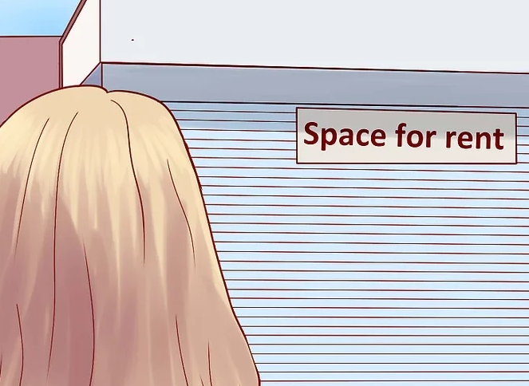
Possible locations for your business
Since our main target is the aged population, it is crucial to understand the number of aged people in the locality. The age considered in this case is people who are 60 years old and above.
Therefore, the business will be directly a great help to the community.

Slide 7

Start-up cost
Our social entrepreneurship venture, Blessings House Mobile Nursing Home has an initial capital of $500, 000.

Slide 8
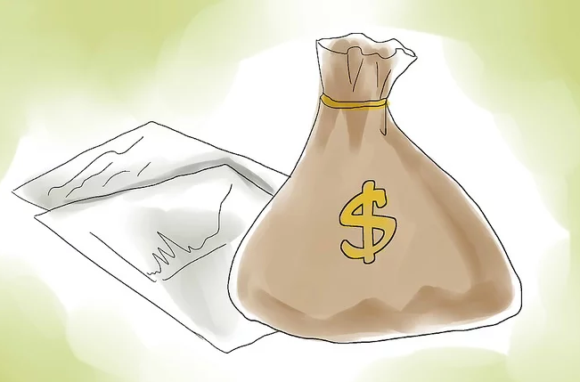
Potential investment
This document presents a business plan on Budgeting and Investing of the $500, 000 worth of capital present for the investment.

Slide 9

Potential investors
Since our company will also be mobile, some amount will also be spent on the purchase of the necessary vehicles such as ambulances and response vehicles for the doctors.

Slide 10

Define your company
The name of the business will be Blessings House Nursing Home. It is a business that will be providing daily assistance to the aged members in the community with various ailments common with the aged.

Slide 11

Winning strategy
Capital strength: The business has half a million dollars, which will cater for the startup expenses.
Active sharing, commitment, and openness ethos geared towards caring for the aged.
Local charities: some organizations with objectives of helping the elderly will get in to assist in the process.
A big number of nurses: there is a big number of nurses in the community who can be giving back to society while earning.
Community Support: The community will be very supportive of the business since it will be healthcare brought closer
Donors. It is a community affair that is likely to attract people with good wishes.

Slide 12

Design your company
This budgeted amount for the startup will be able to provide all the necessary facilities for managing all the conditions related to the business. The first thing to analyze will be how many people are in the resident and the nature of the situation.

Slide 13

Practical issues of running a business
In order to determine the pricing of a condition, two things will be analyzed.

Slide 14
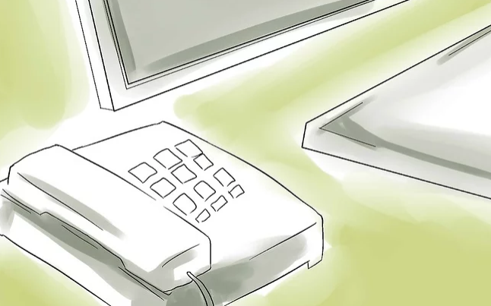
Marketing plan
Also, it is essential to note that the Blessings House Nursing Home will be like social entrepreneurship. This social entrepreneurship will be involving providing the solution to the problem of age-related diseases in the community.

Slide 15

Dynamic sales effort
In a nutshell, this part of your business plan is about how you will attract customers or clients for your product or services

Slide 16

Relevant information about business
The organizational structure of Blessings House Mobile Nursing Home will have its head as the Managing Director. Under the managing director, there will be the medical director, followed by the personnel manager. The medium rank will be the doctors and the clinicians who will be the main people handling the conditions of these aged persons.

Slide 17
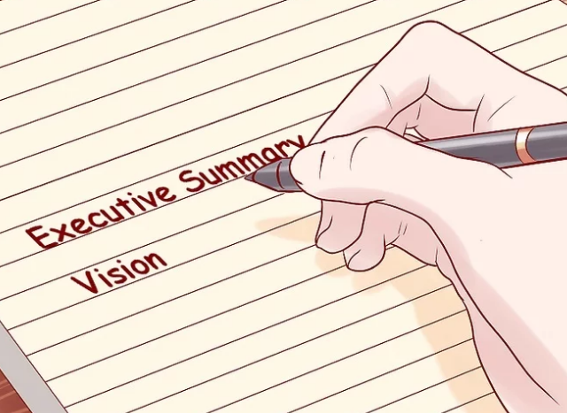
Executive summary last
It will be mobile, and it will be made available to every aged person with some of the conditions that are common with the aged people in the society.

Slide 18

All the information together
The funding model that the business will use the monthly subscription type. All the aged persons whose health will be handled by our facility will be required to make monthly subscriptions for healthcare services. Also, for those old persons who opt for the periodical visits package, they will be required to remit before the start of the package. For those who spend in the facility, they will be paying for the service daily. All these funds will be sustaining the running of the business activities.

Slide 19

Sell yourself and your business
Lowest in the status will be the caretaking personnel who will be handling the older adults who are inpatients in the facility.

Slide 20
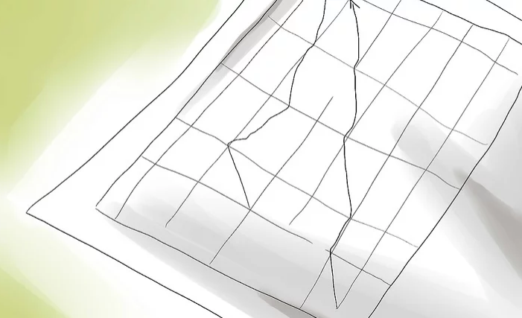
Financial data
The price of two people with similar conditions will be higher than for a single aged person with the same condition understand. Also, the insurance will be a great way to assist in managing the finances for these older adults.

